Slide 1
PC STORE MANAGEMENT SYSTEM
CoreStock
A PyQt5 desktop application for real-time inventory,
stock movement, and supplier management.
Hashir Zahid
Roll No. 2026(S)-CYS-40

Slide 2



WHY CORESTOCK
The Problem with Manual Tracking
Fast-Moving Stock
Human Error
Zero Visibility
GPUs, CPUs, RAM, and monitors change hands constantly — paper records can't keep up.
Manual entry leads to mismatched counts, overselling, and data inconsistencies.
No real-time alerts for low stock — reordering happens too late.
02

Slide 3





PROJECT GOALS
What CoreStock Sets
Out to Do
Secure Login
Role-based authentication for staff access.
05
Full CRUD
Add, edit, search, and delete products across 9 categories.
Auto Stock Tracking
IN/OUT movements update quantities automatically.
core capabilities define
the system's scope.
Supplier Directory
Centralized contact and order management.
Exportable Reports
CSV export for inventory and movement logs.
03

Slide 4
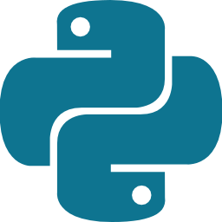




BUILT WITH
Tech Stack
Python 3
PyQt5
SQLite
PyCharm
Git / GitHub
Core language
Desktop GUI framework
Embedded database
Development IDE
Version control & hosting
04

Slide 5



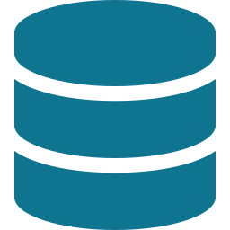
HOW IT'S STRUCTURED
System Architecture
PyQt5 GUI
database.py
SQLite
User interface
Single data layer
products.db
Single data layer. The PyQt5 GUI communicates exclusively through database.py, which handles every query against one SQLite file — ensuring consistency and simplifying maintenance.
05

Slide 6



DATA MODEL
Database Schema
Four tables power the entire system.
users
products
username, password, role
name, category, price, quantity,
low_stock_threshold
suppliers
movements
name, contact, phone, email, address
product_id, type (IN/OUT),
qty, timestamp
06

Slide 7



CORE FEATURE
Products Module
Searchable Table
Add / Edit / Delete
Live filter across all columns.
One reusable dialog drives both actions.
9+ Categories
Low-Stock Alert
GPU, CPU, RAM, Monitor, Storage, PSU, and more.
Visual banner flags items below threshold.
07

Slide 8
OPERATIONS
Stock In / Out & Supplier Reports
Stock Movement
Suppliers & Reports
Auto-adjusts product quantity on every IN/OUT
Blocks overselling — prevents negative stock
Live low-stock banner updates in real time
Full supplier directory with contact details
IN/OUT totals tracked per product
One-click CSV export for reports
08

Slide 9


REFLECTION & ROADMAP
Challenges Solved & What's Next
Key Challenges Solved
Future Enhancements
Stock counts stay in sync via a single data layer
Overselling prevented with quantity validation
One dialog reused for add/edit — less code, fewer bugs
1
Password hashing (bcrypt)
2
Supplier–product linking
3
Sales charts & dashboards
4
PDF report export
09

Slide 10

THANK YOU
Built with CoreStock
A complete, production-ready desktop inventory system
built entirely in Python.
Hashir Zahid
Roll No. 2026(S)-CYS-40
View on GitHub
github.com/Hashirzahyd/HashirZahid_2026S-CYS-40

